Slide 1

SUB-SAHARAN REGION ANALYSIS
Team 9
Roshani Sanghavi
Kanat Osmonov
German Zamora Moreno
Ozan Ciler
Luis Rodas Falla
June Tseng

Slide 2
Agenda
1.
Exploratory Data Analysis
Missing Data: Background
Missing Data: Strategies
Outliers Analysis
Correlation Analysis
Comparison Vs. Other Regions
2.
3.
4.
5.
6.

Slide 3
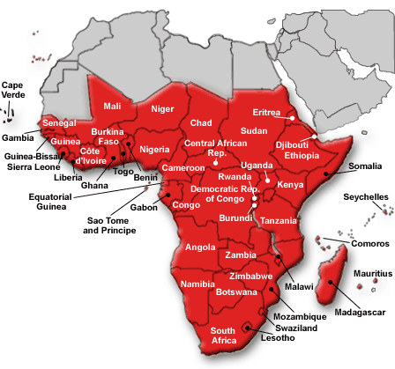
Exploratory data analysis
Region
Data Statistics
Sideswipe
Sub-Saharan Africa
22 Countries
Total Number of Missing Values – 490
Total % of Missing Values – 33.24%
Groups
Employment
Demographics
Health
Education
Economics
Services
Notes:
Fertility Rates - Health, Poverty head count ratio - Economics, Urban Population Growth– Demographics ,
Mobile Subscription and Access to Electricity
Why not services – the correlation was high but it doesn’t make sense with the country with high poverty and less access to electricity
Summary of the findings from python, detail the groups.
Use graphs, transitions, smart art, example:

Slide 4

Missing Data: Background
National Statistics Offices ;
Discrepancies
Donor priorities
Concerns
Limited budget
Lack of independence

Slide 5




Missing Data: Strategies
Discard
Impute
Web Search
Latest Value

Slide 6
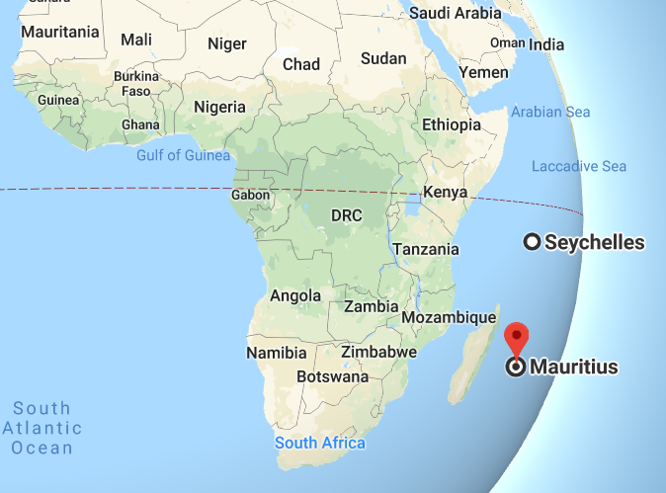

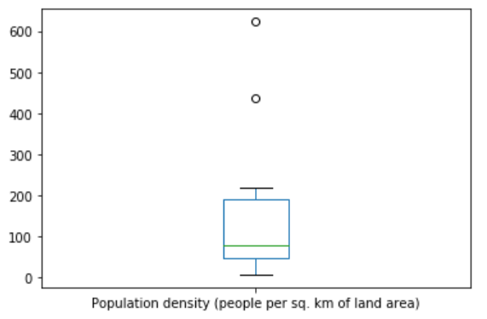
Outliers analysis
APPROACH
Database outliers 3%
Outliers + Correlation Analysis
Mauritius & Seychelles removed:
Population density: 6X and 4X avg. -0.87 corr. vs. urban population
Variables
41%
Countries
63%
28% Mauritius
18% Seychelles

Slide 7
Correlation analysis
Navigating through correlation matrix
Correlation ranges of interest:
[0.6, 1.0] & [-1.0, -0.6]
Insights power
Poverty headcount ratio $3.20 vs. access to electricity:
-0.85
Population density vs. Adolescent fertility rate
Understanding the region
Internet research to understand social dynamics:
News
Country reports
-0.60

Slide 8
Correlation analysis
Population density vs. Adolescent fertility rate
Prevalence of underweight vs. Poverty headcount ratio at $1.90 a day
Poverty headcount ratio at $1.90 a day vs. Employment in services
Employment in services vs. Life expectancy at birth
-0.60
0.72
-0.63
0.62

Slide 9
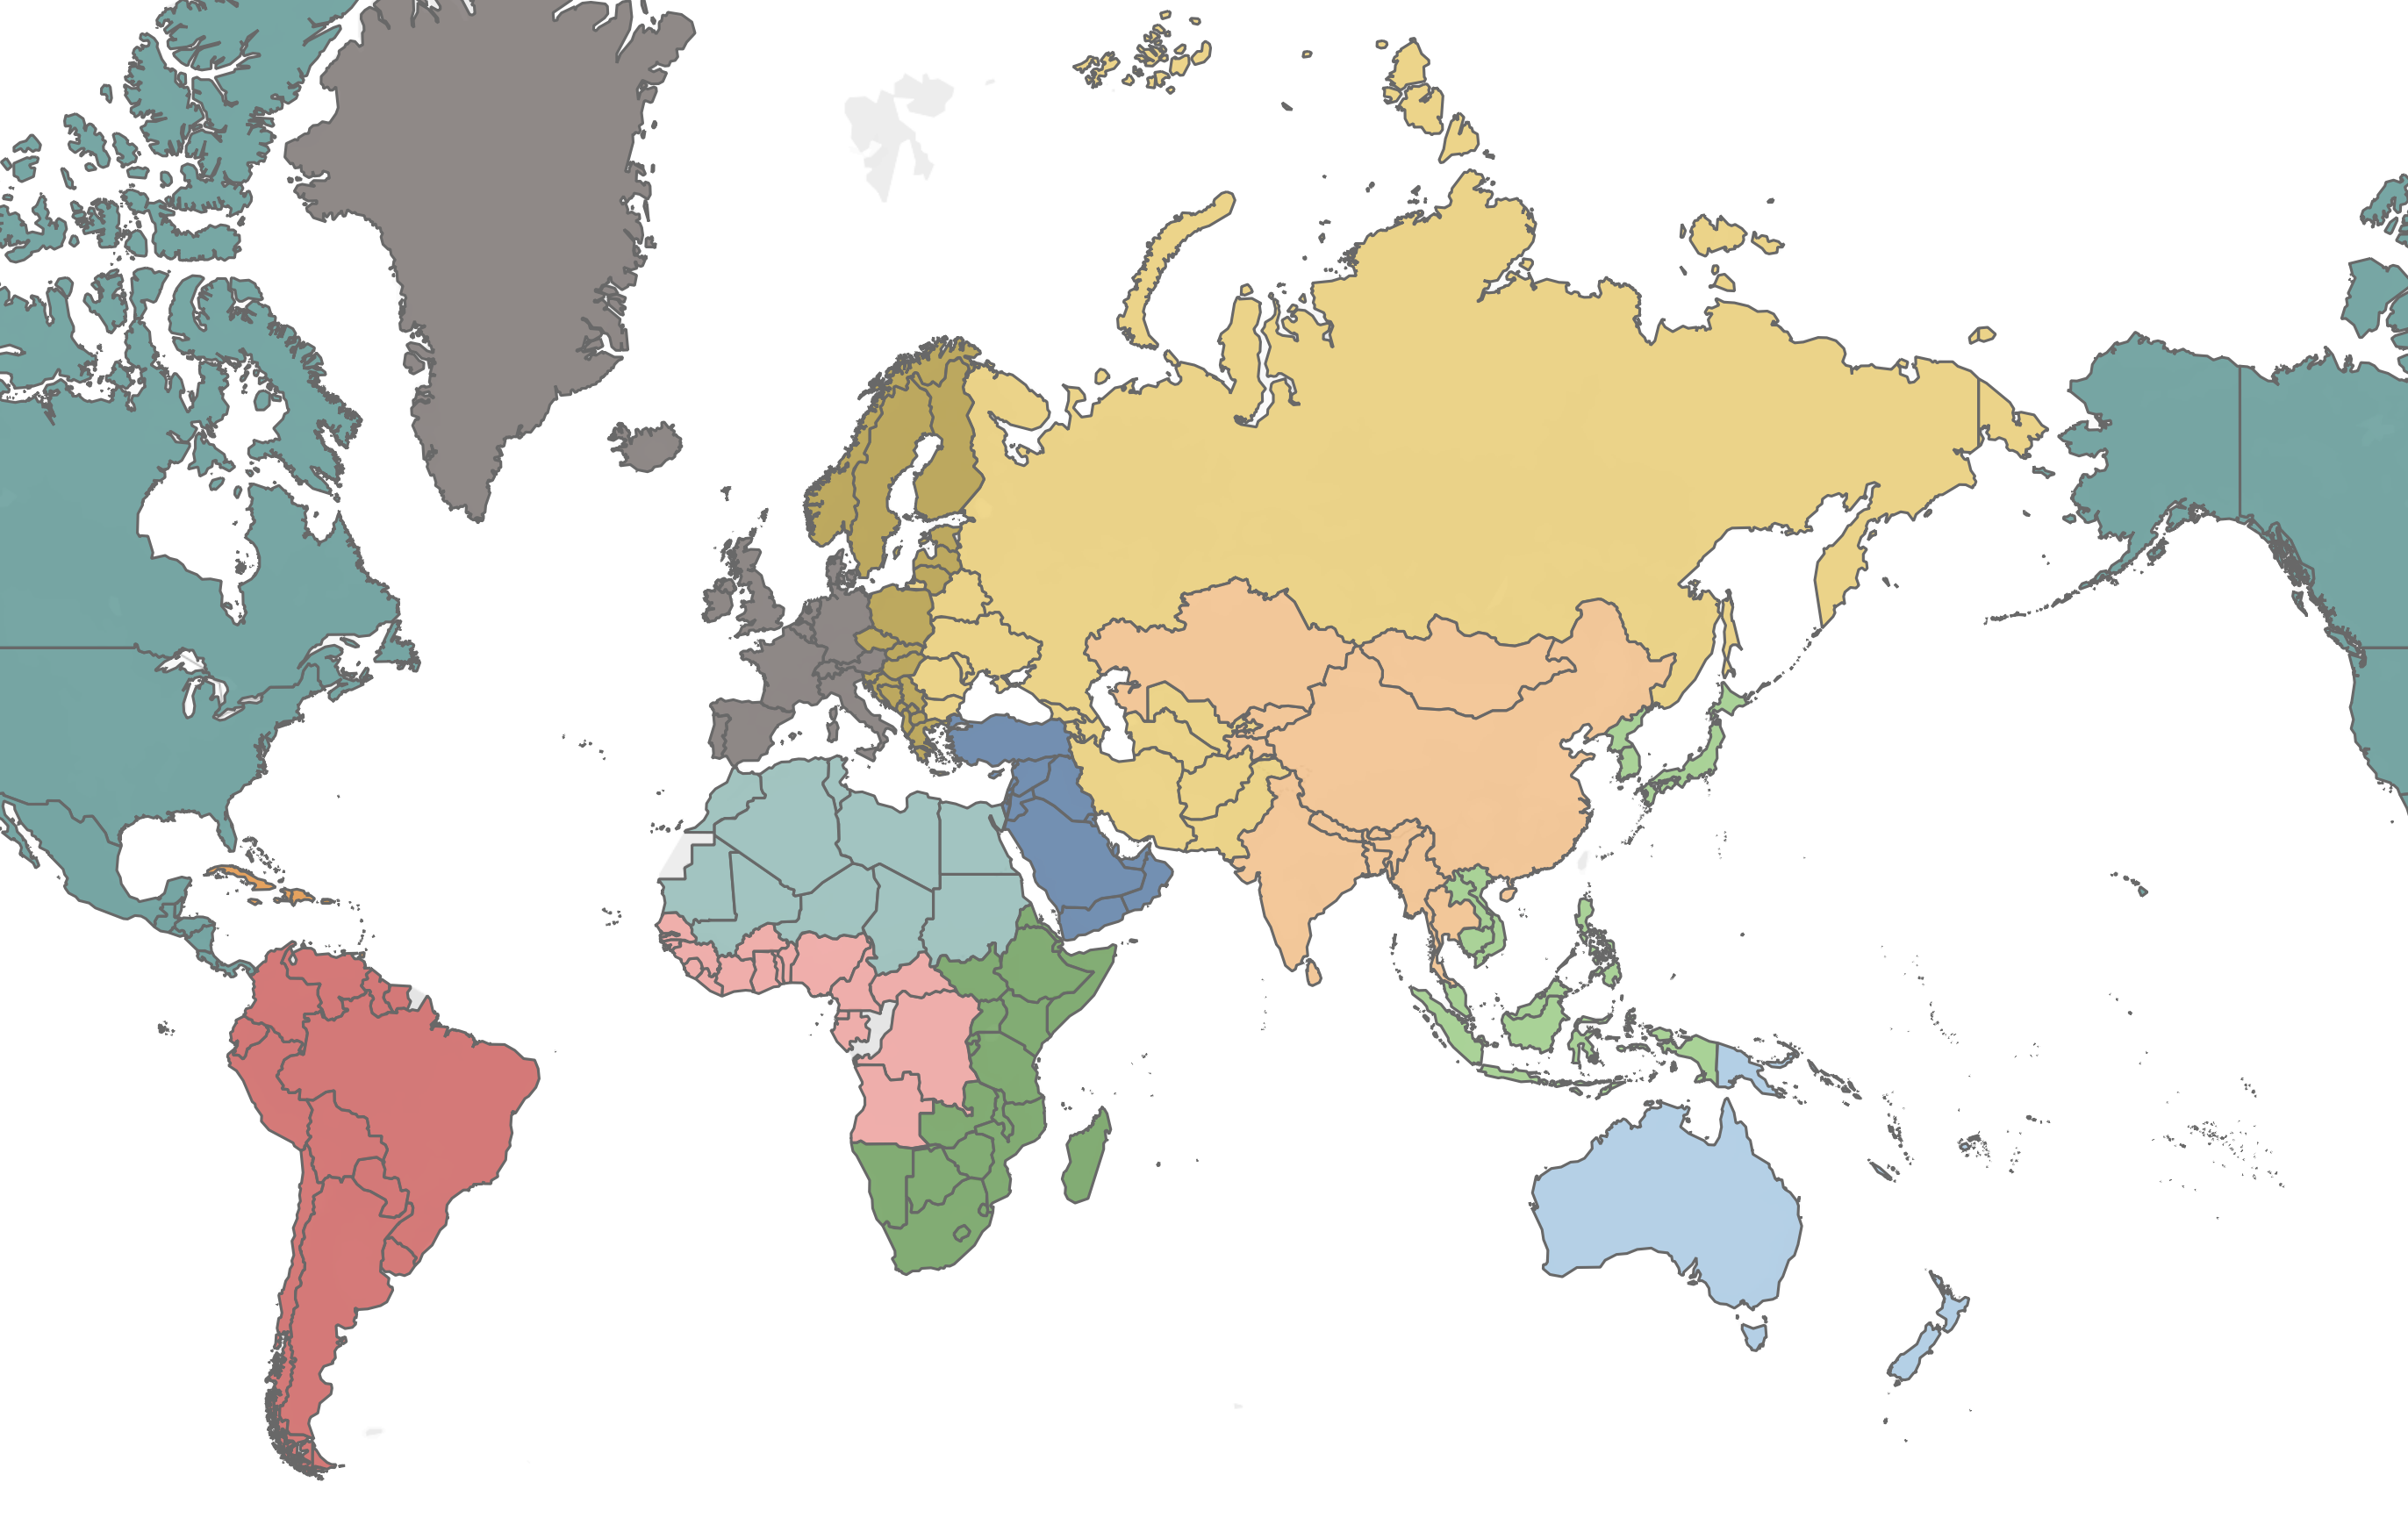




Comparison v.s. Other regions
Demographics and employment
Western Europe
Arabian Peninsula
World Average
South America
Sub-Saharan
Africa

Slide 10
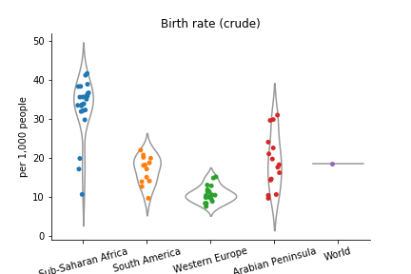
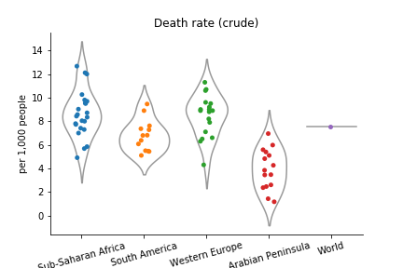
Comparison v.s. Other Regions
Two times as high birth rate
Family planning
Sub Sahara death rate World average
Larger population in the long-term
Notes:
https://www.populationconnection.org/africa-globaldev/
https://www.weforum.org/agenda/2016/05/why-are-fertility-rates-so-high-in-sub-saharan-Africa

Slide 11
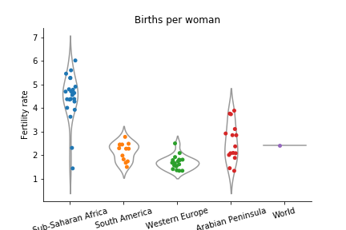
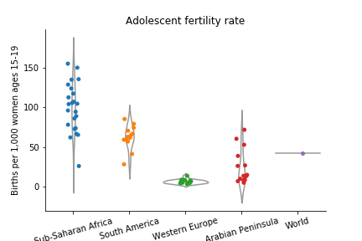
Comparison v.s. Other Regions
“It was a measure of prestige, respect and honor that they held in society given that children ensured family name continuation."
Notes:
https://www.populationconnection.org/africa-globaldev/

Slide 12
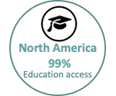
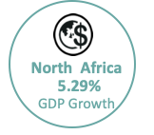
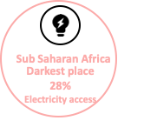
Comparison v.s. Other regions
Notes:
Lastly, we highlight some insights that interests us. About the education accessibility, the North America has the highest education accessibility because of the strong economy entity and government policy support. North Africa has strong GDP growth in 2017 compared to other countries, especially in Libya. In 2017 Libya had a sharp growth in oil revenue that was 14 Billions oil revenue because they re-opend its oil export terminal and had huge export to China. And Sub Saharan Africa has the lowest electricity rate in the world.
US Education 2017
The Obama Administration released a fiscal year 2017 budget today that makes crucial investments building on the Administration's work to advance educational equity and excellence, support teachers and school leaders, and promote college access, affordability and completion.
https://www.ed.gov/news/press-releases/president-obamas-2017-budget-seeks-expand-educational-opportunity-all-students
North Africa Economy 2017 –Region average
North-Africa-region's has strong GDP growth rate, the country that stands out the ratio is Libya, which was 26% of annual GDP growth.
In 2017, Libya had a sharp growth in oil reveneue which was 14 Billions oil revenue . This is because Libya reopend its oil export terminal and export to China.
https://www.reuters.com/article/libya-economy/libyan-oil-revenues-up-sharply-in-2017-budget-deficit-halved-cenbank-idUSL8N1P027T
https://oilprice.com/Latest-Energy-News/World-News/Libyas-2018-Oil-Exports-To-China-Double-On-2017.html
Sub Sahara Africa Electricity accessibilty 2017-
SSA has the lowset electricity accessibility, 48%, only half of the global average access rate. Government regulations plays a key rold of the accessibity of electricity
From World banks report, there was only half of 35 countries in Africa have an officially approved electrification plan. Some countries have a nice GDP performance but the government did not distribute much resource in electricity construction, such as Congo, Rep.
https://openknowledge.worldbank.org/bitstream/handle/10986/31333/9781464813610.pdf?sequence=6&isAllowed=y
https://rise.esmap.org/data/files/reports/rise_2018_-_access_to_electricity_0.pdf

Slide 13

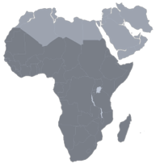


Comparison v.s. Other regions
The lowest electricity accessibility, 48%,
only half of the global average access rate.
Spend 20% of the gov expenditure
but have lowest rate of the education accessibility.
The average GDP growth of Sub-Saharan is 4.21%,
their economy is booming but not stable
Notes:
So the problem for Sub Saharan Africa's electricity is that government did not make enough practical plans for the construction. From World banks report, there was only half of 35 countries in Africa have an officially approved electrification plan. Some countries have a nice GDP performance but the government did not distribute much resource in electricity construction, such as Congo, Rep. Large population, linguistic diversity and resource constrains are the challenges for their education development. The GDP growth is booming in sub Saharan Africa but not stable because its mostly contributed by natural resource such as oil that had unsteady price in 2017.
Sub Saharan Africa Education 2017-
Spend the high distribution 20% of the government expenditure on education but have lowest rate of the education accessibility.
https://openknowledge.worldbank.org/bitstream/handle/10986/29377/9781464812606.pdf?sequence=14&isAllowed=y
Sub-Saharan African countries facing three challenges:
(a) large population (27 million in 1995);
(b) linguistic diversity (index value of 0.93, indicating about a 93 percent probability that two randomly selected inhabitants would have different mother tongues)
(c) low growth of GDP per capita.
Economic 2017-
The average GDP growth of Sub-Saharan is 4.21, their economy is booming but not stable
Supported by modestly rising commodity prices, strengthening external demand, and the end of drought in a number of countries. Security threats have subsided in several countries. Several factors are preventing a more robust recovery. In Angola and Nigeria, tight foreign exchange liquidity conditions, reflecting distortions in the foreign exchange market, constrain activity in the non-oil sector.
https://openknowledge.worldbank.org/bitstream/handle/10986/29377/9781464812606.pdf?sequence=14&isAllowed=y
Sub Sahara Africa Electricity accessibilty 2017-
SSA has the lowset electricity accessibility, 48%, only half of the global average access rate. Government regulations plays a key rold of the accessibity of electricity
From World banks report, there was only half of 35 countries in Africa have an officially approved electrification plan. Some countries have a nice GDP performance but the government did not distribute much resource in electricity construction, such as Congo, Rep.

Slide 14
THANK YOU!
Notes:
Even their economy has great GDP growth
Because the growing popoulation,

